Slide 1
TEETH DETECTION & DENTAL PROBLEM CLASSIFICATION IN PANORAMIC X-RAY IMAGES USING DEEP LEARNING AND IMAGE PROCESSING TECHNIQUES
NAMITHA C
Roll No : 36
Product Owner : Mr. MOHAMMAD JABIR C

Slide 2
TABLE OF CONTENTS
Introduction
Modules
Data Flow Diagram
Table Design
Developing Environment
User stories
Product backlog
Project Plan
Sprint plans
Sprint actual

Slide 3
INTRODUCTION
Abstract— Deep convolutional neural networks, have gained a lot popularity in medical research due to their impressive results in detection, prediction and classification. Panoramic X-ray is a 2 dimensional dental X-ray that captures the entire mouth in a single image including the teeth ,upper and lower jaws, surrounding structures and tissues. Analysis of panoramic dental radiographies help specialists observe problems in poor visibility areas, inside the buccal cavity or in hard to reach areas. However, poor image quality or fatigue can cause the diagnosis to vary, which can ultimately hinder the treatment. In this paper we propose a novel approach of automatic teeth detection and dental problem classification using panoramic X-Ray images which can aid the medical staff in making decisions regarding the correct diagnosis. For this endeavor panoramic radiographies were collected from three dental clinics and annotated, highlighting 14 different dental issues that can appear. A CNN was trained using the annotated data for obtaining semantic segmentation information. Semantic segmentation is process of assigning a label to every pixel in the image for complete scene understanding, the algorithm should figure out the object and it’s pixels. After segmentation ,teeth detection, then refinement and classification done. After refinement and classification majority voting operation is performed in order to find the main semantic class of each tooth, which corresponds to the dental problem affecting the tooth.CNN extract the feature of image and convert it into lower dimension without loosing its characteristics.

Slide 4
MODULES
ADMIN
Login
View users
Add tips
View feedback
Add and manage dataset
Add hospitals

Slide 5
2. USER
Register
Login
View tips
Feedback
Upload X-Ray image
Upload X-Ray image and predict problem
View nearest hospital

Slide 6
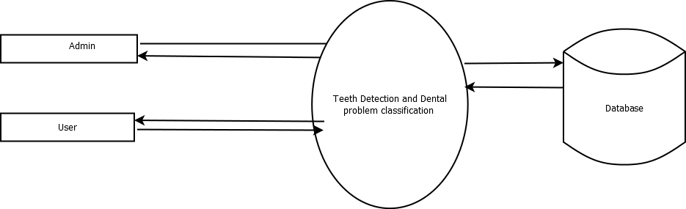
DATA FLOW DIAGRAM Level- 0

Slide 7
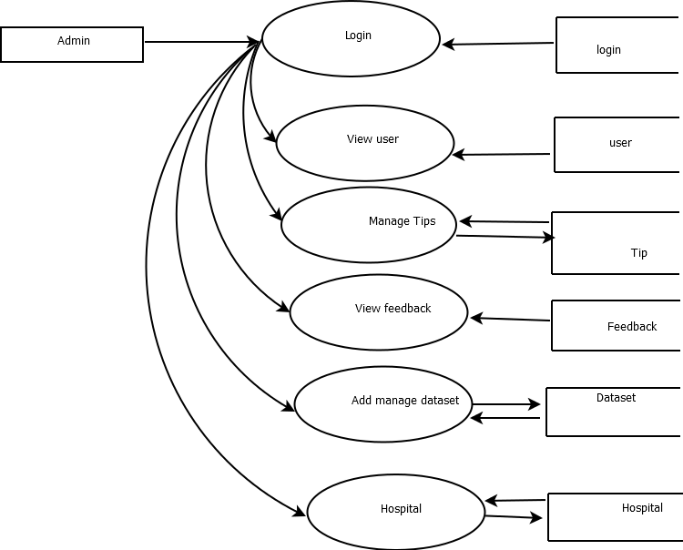

Slide 8
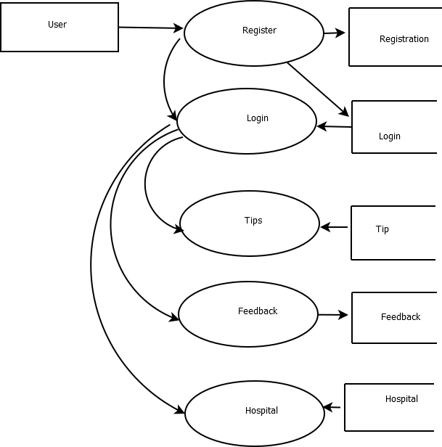

Slide 9
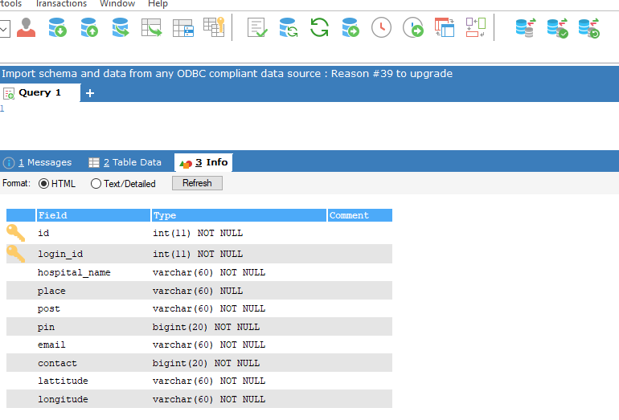
Table Design

Slide 10
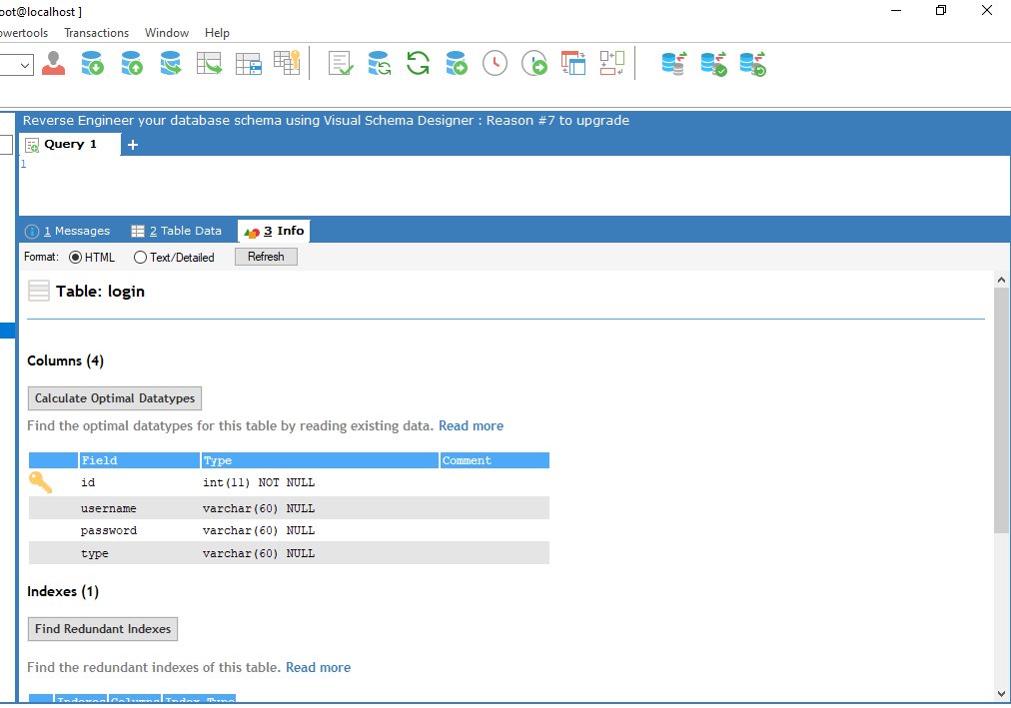

Slide 11
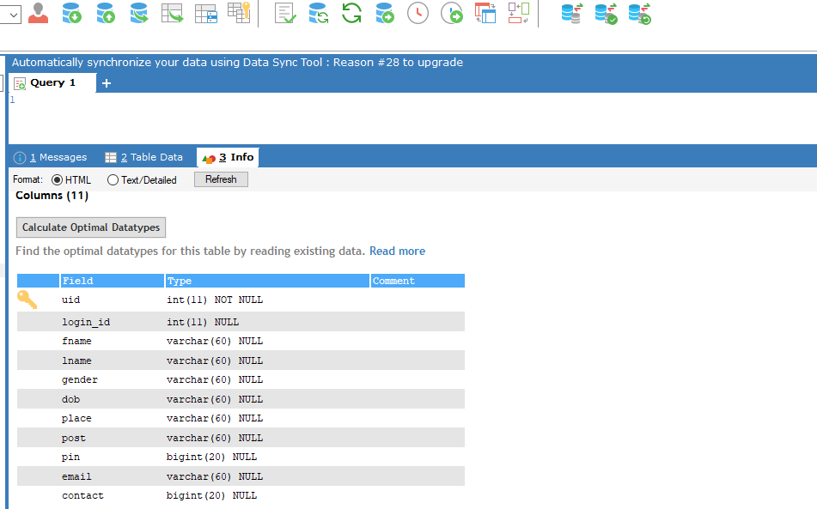

Slide 12
DEVELOPMENT ENVIORNMENT
Software Requirements
OPERATING SYSTEM: WINDOWS 10
FRONT END: HTML, CSS, JAVASCRIPT
BACK END: Mysql
IDE: Jetbrains Pycharm, Android studio
TECHNOLOGY USED: PYTHON,JAVA
FRAME WORK USED: Flask

Slide 13
USER STORIES
UserStoryID | As a <type of user> | I want to | So that I can
1 | Admin | login | login successful with correct username and password
2 | Admin | Manage hospitals | Add,view,edit&delete hospitals
3 | Admin | View users | View all registered users
4 | Admin | Add tips | Add tips to help users
5 | Admin | View feedback | View feedback about doctor from users
6 | User | Login | login successful with correct username and password
7 | User | View tips | View all tips from admin
8 | User | Feedback | Provide feedback to admin
9 | User | Upload image | uploads the image and views the result
10 | User | View nearest Hospital | Views nearest hospital for consulting doctor

Slide 14
PRODUCT BACKLOG
User Story ID | Priority <High/Medium/Low> | Size (Hours) | Sprint <#> | Status <Planned/In progress/Completed> | Release Date | Release Goal
1 | Medium | 2 | 1 | Completed |  | Table design
2 | High | 3 |  | Completed |  | Form design
3 | High | 5 |  | Completed |  | Basic coding
3 | Medium | 5 | 2 | Planned |  | Creation of dataset
4 | High | 5 |  | Planned |  | Pre-processing x-ray images
5 | High | 5 | 3 | Planned |  | prediction
6 | high | 5 |  | Planned |  | User prediction process.
7 | Medium | 5 | 4 | Planned |  | Testing data
8 | High | 5 |  | Planned |  | Output generation

Slide 15
PROJECT PLAN
User Story ID | Task Name | Start Date | End Date | Days | Status
1 | Sprint 1 | 26/12/2021 | 28/12/2021 | 2 | Completed
2 |  | 29/12/2021 | 31/12/2021 | 3 | Completed
3 |  | 03/12/2021 | 08/01/2022 | 5 | Completed
4 | Sprint 2 | 09/01/2022 | 16/01/2022 | 8 | Planned
5 |  | 18/01/2022 | 22/01/2022 | 5 | Planned
6 | Sprint 3 | 23/01/2022 | 27/01/2022 | 5 | Planned
7 |  | 30/01/2022 | 05/02/2022 | 7 | Planned
8 | Sprint 4 | 06/02/2022 | 10/01/2022 | 5 | Planned
9 |  | 16/02/2022 | 19/02/2022 | 4 | Planned

Slide 16
SPRINT BACKLOG PLAN
Backlog Item | Status & completion date | Original estimate in hours | Day1 | Day2 | Day3 | Day4 | Day5 | Day6 | Day7 | Day8 | Day9 | Day10 | Day11 | Day12 | Day13 | Day14
User story #1,#2,#3,#4 |  | hrs | hrs | hrs | hrs | hrs | hrs | hrs | hrs | hrs | hrs | hrs | hrs | hrs | hrs | hrs
Table design | 28/12/2021 | 2 | 1 | 1 | 0 | 0 | 0 | 0 | 0 | 0 | 0 | 0 | 0 | 0 | 0 | 0
Form design | 31/12/2021 | 3 | 0 | 0 | 0 | 1 | 1 | 1 | 0 | 0 | 0 | 0 | 0 | 0 | 0 | 0
Coding | 08/01/2021 | 5 | 0 | 0 | 0 | 0 | 0 | 0 | 0 | 0 | 0 | 1 | 1 | 1 | 1 | 1
User story #5,#6,#7,#8
Creation of dataset | 16/01/2022 | 5 | 1 | 1 | 0 | 1 | 0 | 1 | 0 | 1 | 0 | 0 | 0 | 0 | 0 | 0
Pre-processing x-ray images | 22/01/2022 | 5 | 0 | 0 | 0 | 0 | 0 | 0 | 0 | 0 | 0 | 1 | 1 | 1 | 1 | 1
prediction | 27/01/2022 | 5 | 1 | 1 | 1 | 1 | 1 | 0 | 0 | 0 | 0 | 0 | 0 | 0 | 0 | 0
User prediction process | 05/02/2022 | 5 | 0 | 0 | 0 | 0 | 0 | 0 | 0 | 1 | 0 | 1 | 1 | 1 | 0 | 1
Testing data | 10/01/2022 | 5 | 1 | 1 | 1 | 1 | 1 | 0 | 0 | 0 | 0 | 0 | 0 | 0 | 0 | 0
User story #9
Output generation | 20/02/2022 | 5 | 0 | 0 | 0 | 0 | 0 | 0 | 0 | 0 | 0 | 2 | 1 | 1 | 1 | 1
Total l |  | 40 | 4 | 4 | 2 | 4 | 3 | 2 | 0 | 2 | 0 | 5 | 4 | 4 | 3 | 4

Slide 17
SPRINT ACTUAL
Backlog Item | Status & completion date | Original estimate in hours | Day1 | Day2 | Day3 | Day4 | Day5 | Day6 | Day7 | Day8 | Day9 | Day10 | Day11 | Day12 | Day13 | Day14
User story #1,#2,#3,#4 |  | hrs | hrs | hrs | hrs | hrs | hrs | hrs | hrs | hrs | hrs | hrs | hrs | hrs | hrs | hrs
Table design | 28/12/2021 | 3 | 1 | 1 | 0 | 0 | 0 | 0 | 0 | 0 | 0 | 0 | 0 | 0 | 0 | 0
Form design | 31/12/2021 | 2 | 0 | 0 | 0 | 1 | 1 | 1 | 0 | 0 | 0 | 0 | 0 | 0 | 0 | 0
Coding | 08/01/2021 | 5 | 0 | 0 | 0 | 0 | 0 | 0 | 0 | 0 | 0 | 1 | 1 | 1 | 1 | 1
User story #5,#6,#7,#8
Creation of dataset
Pre-processing x-ray images
Prediction
User prediction process
Testing data
User story #9
Output generation
Total |  | 10 | 1 | 1 | 0 | 1 | 1 | 1 | 0 | 0 | 0 | 1 | 1 | 1 | 1 | 1

Slide 18
THANK YOU

